Slide 1

EXL Foundation Track Training
Final Project:Predicting Employee Attrition
Team 1
Arun Gera

Slide 2
Contents
Objective/Problem statement
Project Flow
Tools Used
My Contribution
Results
Conclusion
Summary

Slide 3
Objective
The core objective of the project is to build a machine learning model that can predict the employee attrition, i.e., whether an employee is expected to leave an organization or not. Docker is used for deployment.

Slide 4
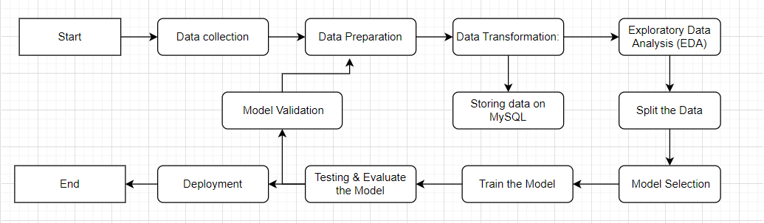
Project Flow

Slide 5
Tools Used
Google Colab
MySQL
VS Code
Git & Github
Docker & DockerHub
Jenkins

Slide 6
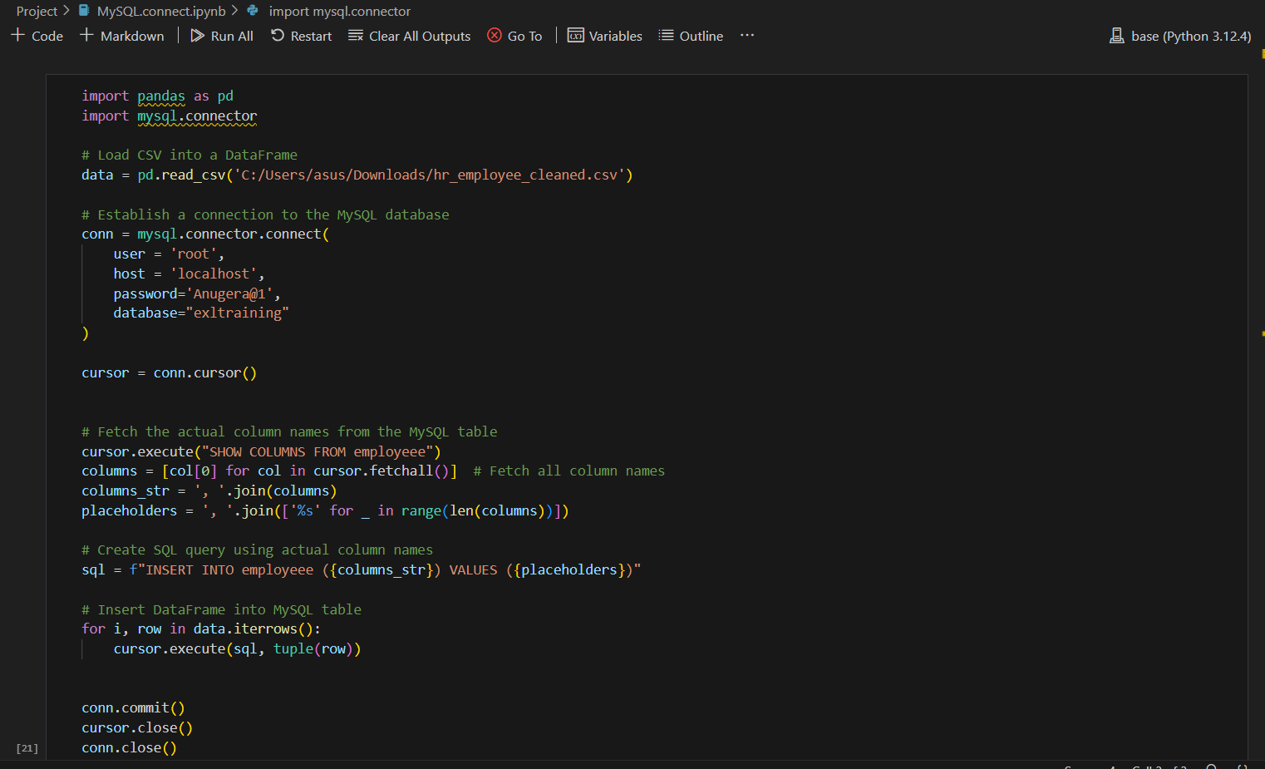
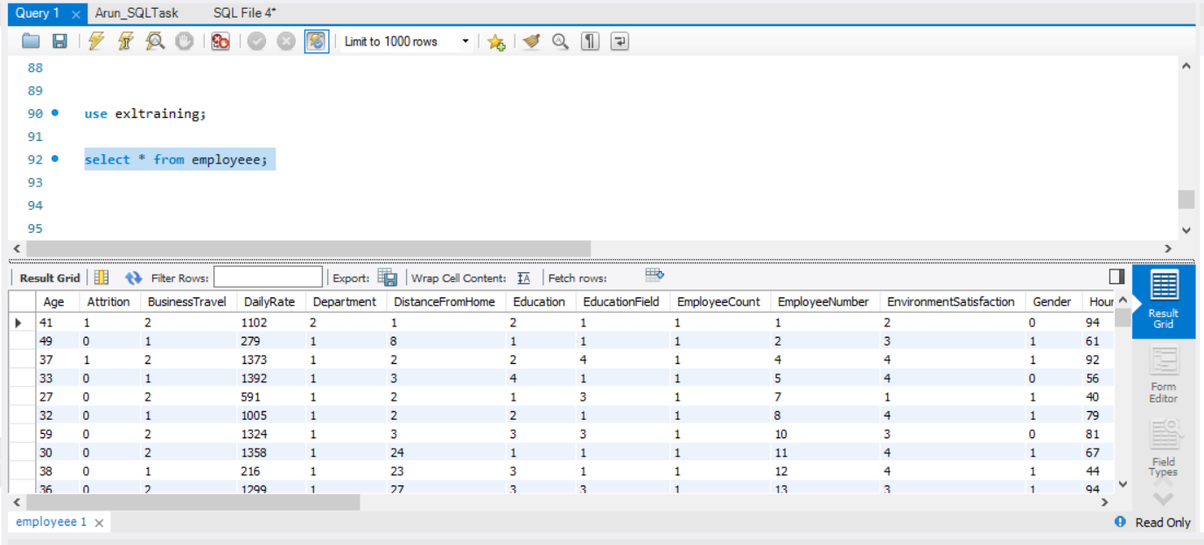
My Contribution Loading cleaned data into MySQL database

Slide 7
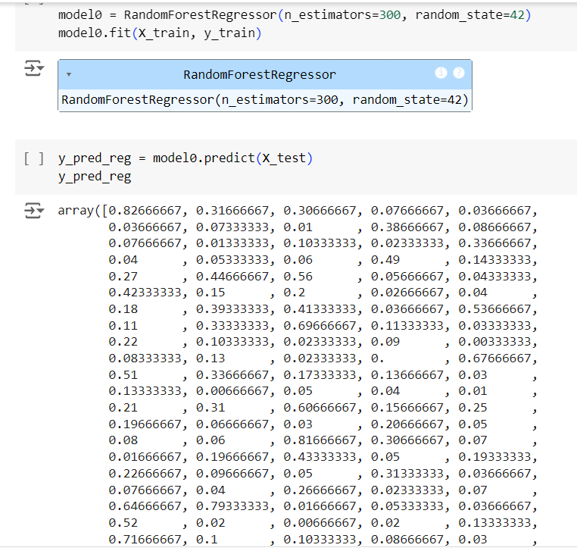
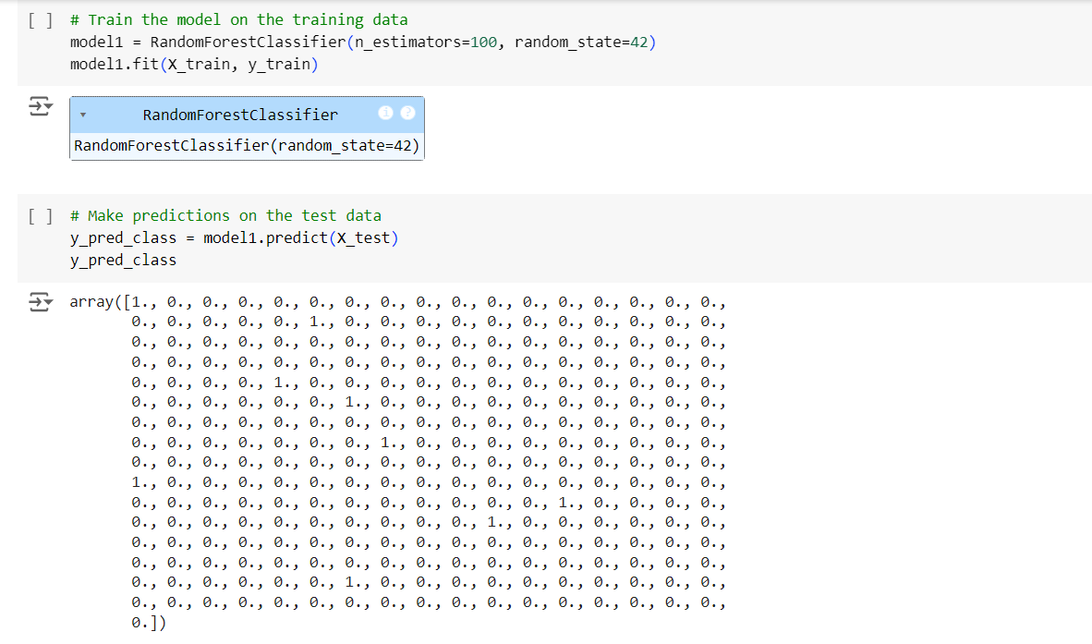
My Contribution Train the cleaned data on a Random Forest Regressor for regression tasks and on a Random Forest Classifier for classification tasks

Slide 8
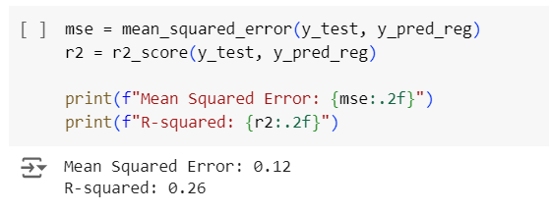
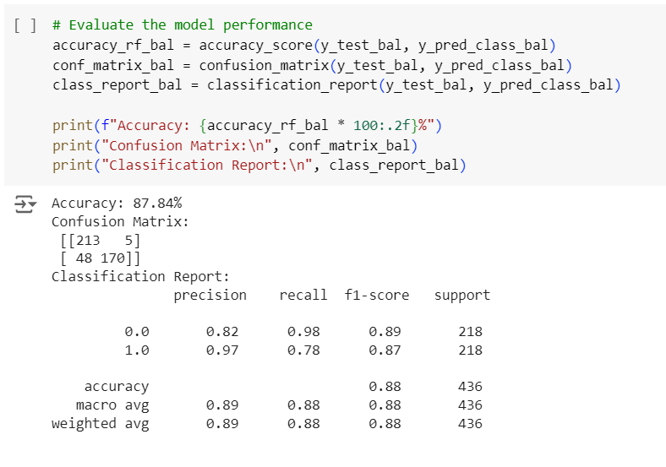
My Contribution Evaluating both the models using appropriate evaluation metrics

Slide 9
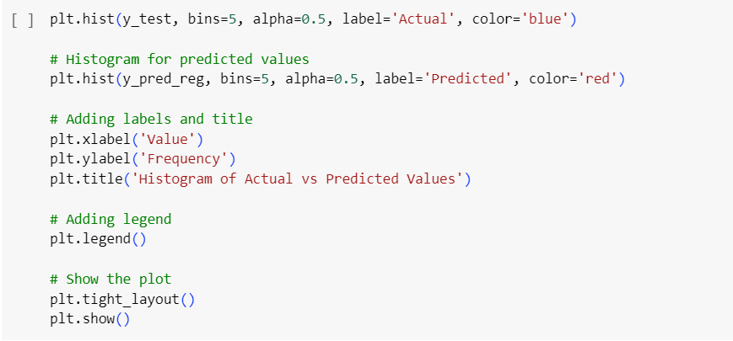
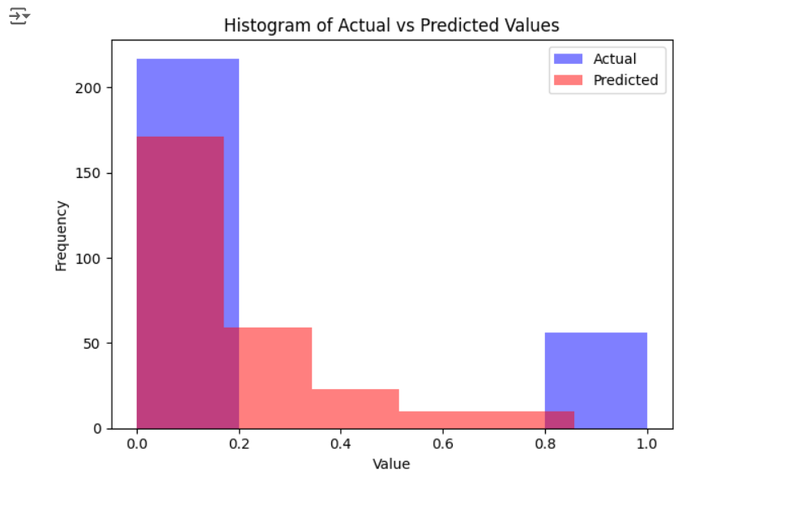
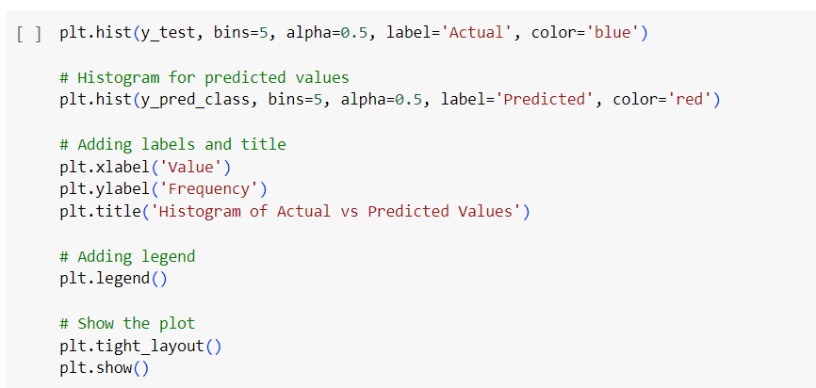
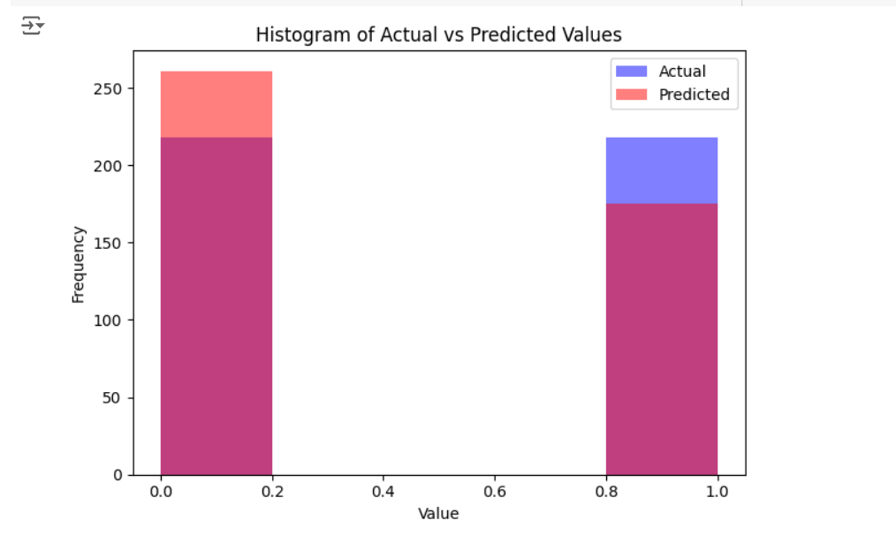
My Contribution visualizing the results of models

Slide 10
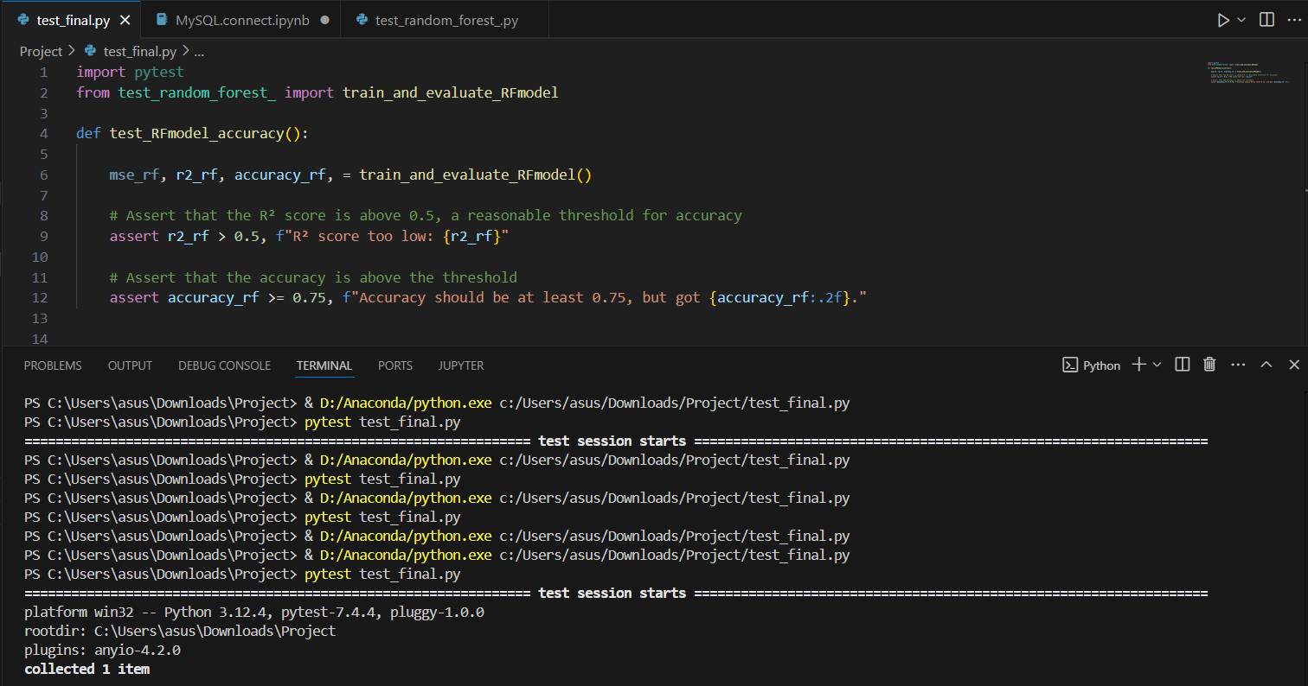
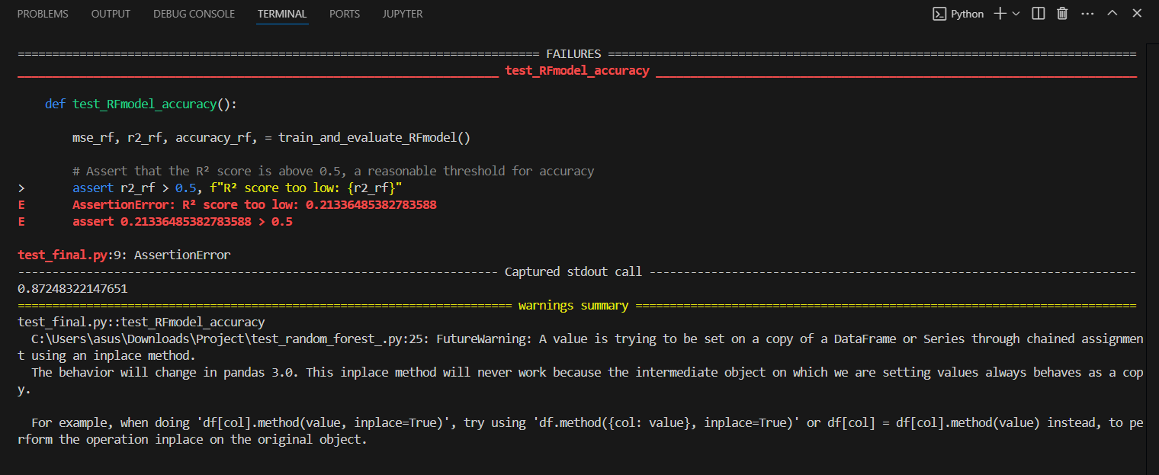
My Contribution Pytest on the results of models

Slide 11
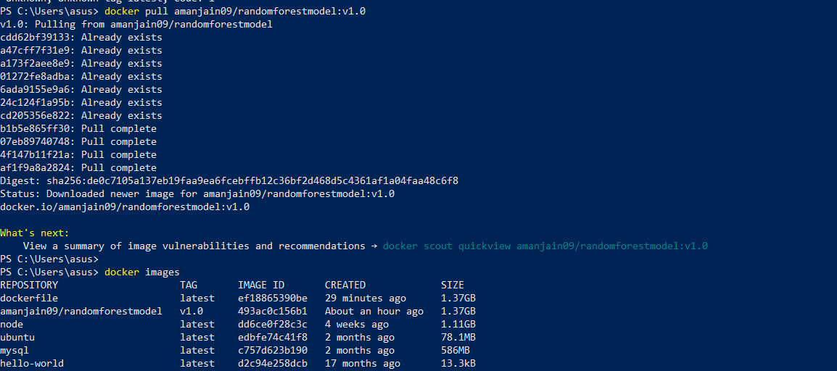
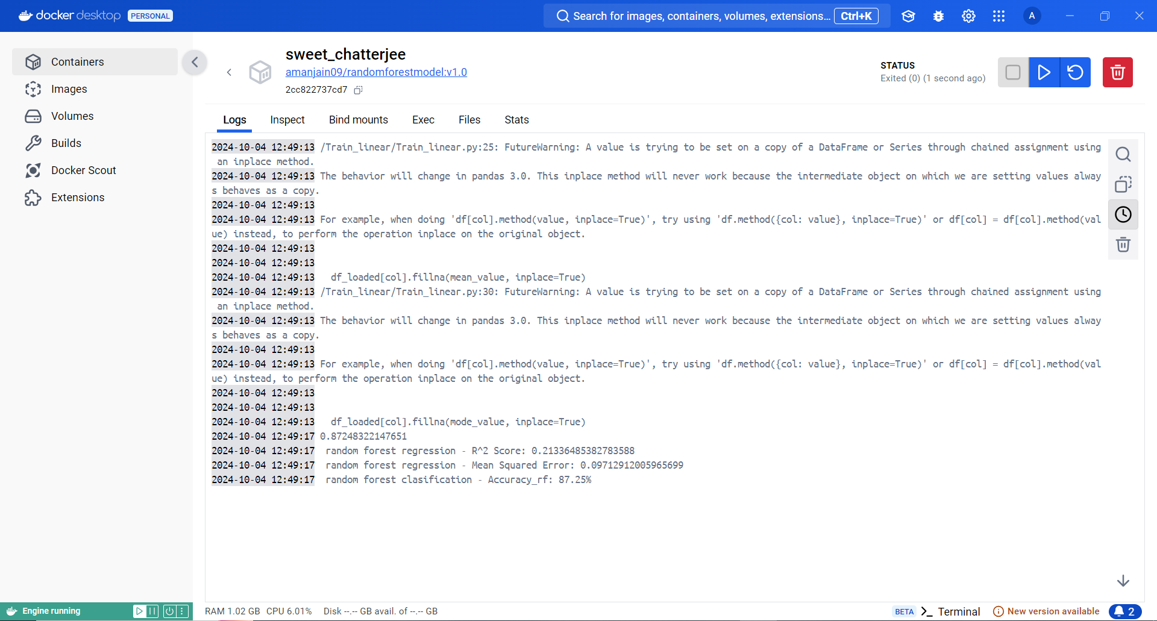
My Contribution Pulling and running the docker image

Slide 12
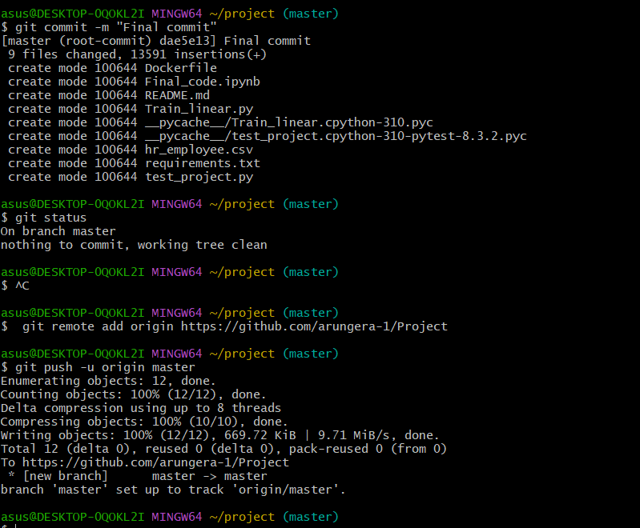
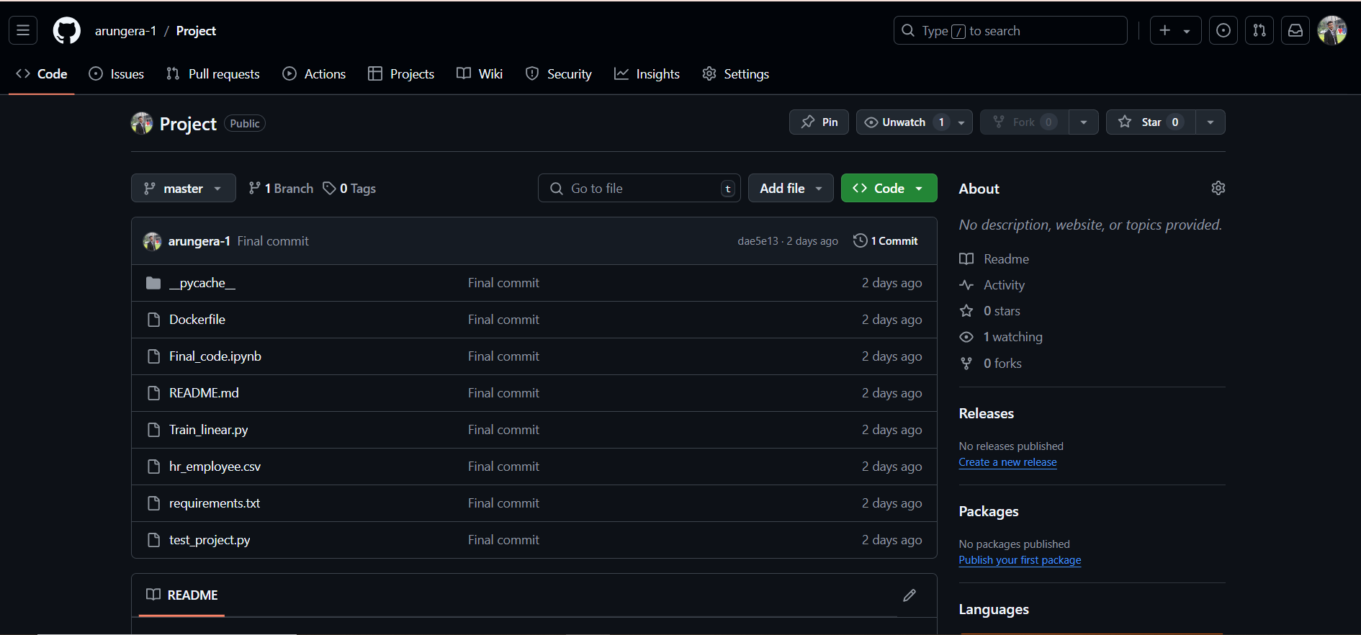
My Contribution Pushing the project on Github

Slide 13
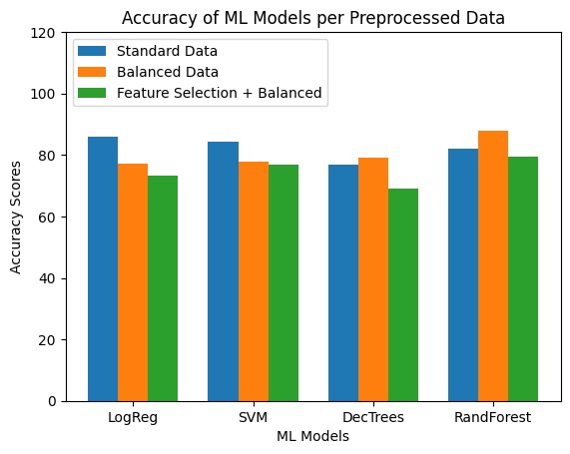
Results

Slide 14
Conclusion
This project is an implementation of various machine learning models that is trained on a dataset that is based on employee attrition. This data is transformed and preprocessed to achieve better results. Further docker and jenkins are used for deployment.

Slide 15
Summary
Successfully developed and deployed a machine learning model for predicting employee attrition.
Integrated with a database for data management.
Used Docker to containerize the code
Deployed on Jenkins for CI/CD.
Deployed the entire project on GitHub for version control and future collaboration

